Slide 1
Introduction to R

Slide 2
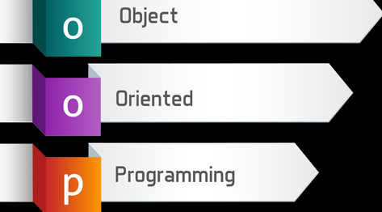
Object-oriented programming is a programming method based on the concept of "objects", which may contain data and code.
Generally in R, it’s functional programming because you typically solve problems using functions, not just objects
Notes:
OOP combines the data structures and algorithms of a software entity inside the same box.

Slide 3

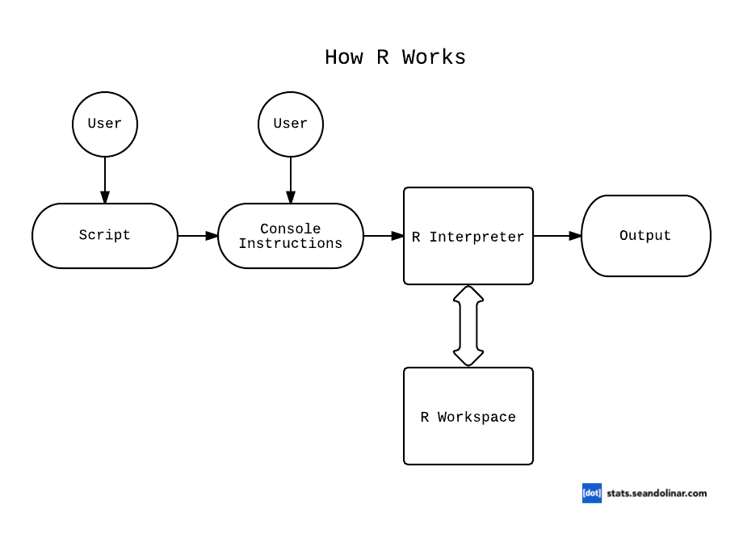
Open Source R

Slide 4
About
Used for data manipulation and numerical calculations, specially statistical applications. Its strength is in the large number of specially built-in statistical functions.
Originally called the S programming language
Developed by Bell Labs in the 1970s.
Freely available through the internet from the Comprehensive R archive Network (CRAN).
Work in an environment called Workspace that contains objects (which are easily accessible) that are ready to be called on to perform tasks.
Two versions that are freely available R GUI and R Studio

Slide 5
Introduction: R Studio
R Studio is an IDE – Integrated Development Environment.
More user friendly environment.
Replaces the R GUI.
R Studio is a commercial entity.
It is free and available at http://www.rstudio.com/

Slide 6
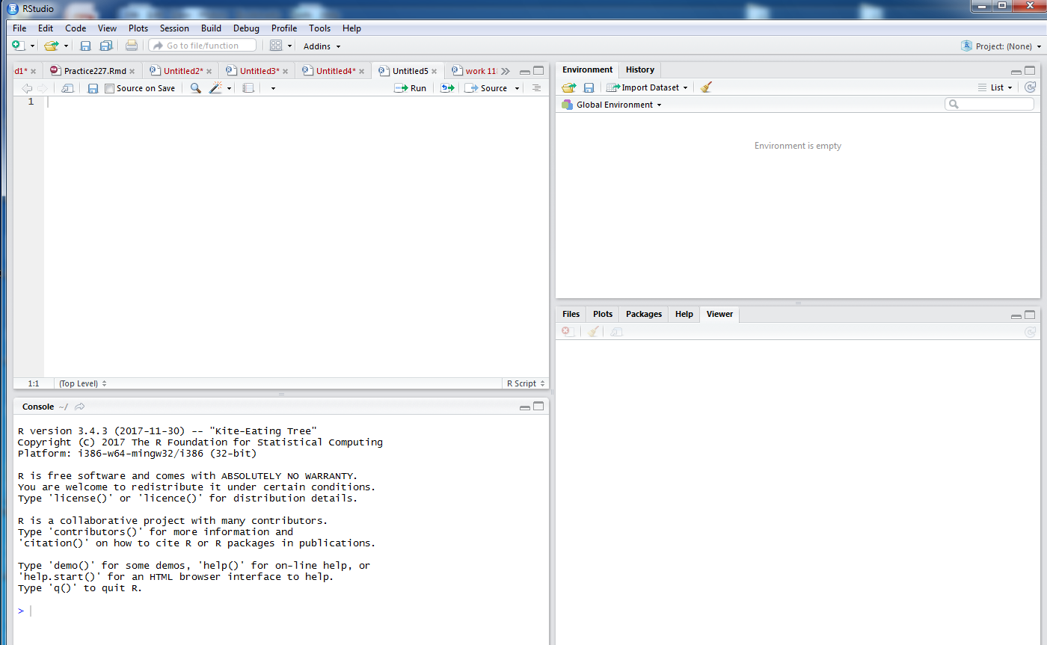
R Studio
Script window
Environment/ History
Console
Notes:
Introduction
RStudio allows the user to run R in a more user
-
friendly
environment. It is open
-
source (i.e. free) and available at
http://www.rstudio.com/

Slide 7
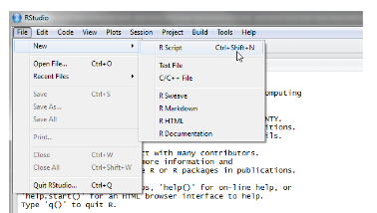
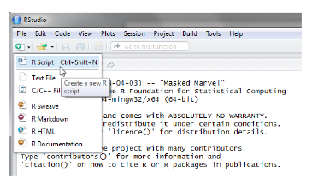
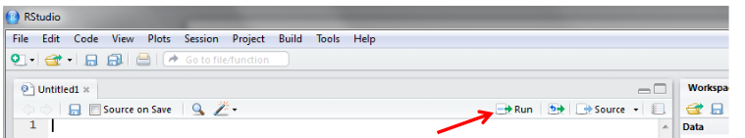
R Studio
To create a new R script you can either go to File -> New-> R Script
, or click on the icon with the “+” sign and select “R Script”, or simply press Ctrl+Shift+N.
To run lines of code leave the cursor anywhere on the line where the code is and click on “Run” or “ press Ctrl +r

Slide 8
Warning and Error messages
line “x” + 1 tells you in which line of code you have an error. Then it tells you what the error is.
R always tells you in which code the error occurs, so you know in many cases where you have to start looking.
* Error messages are not always clear.

Slide 9
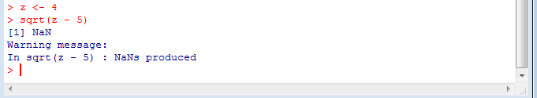
Warning and Error messages
Most warnings point to one of the following problems:
Function couldn’t deal with some of the arguments and ignored them
Function gave you a result, but for some reason that result may not be correct

Slide 10

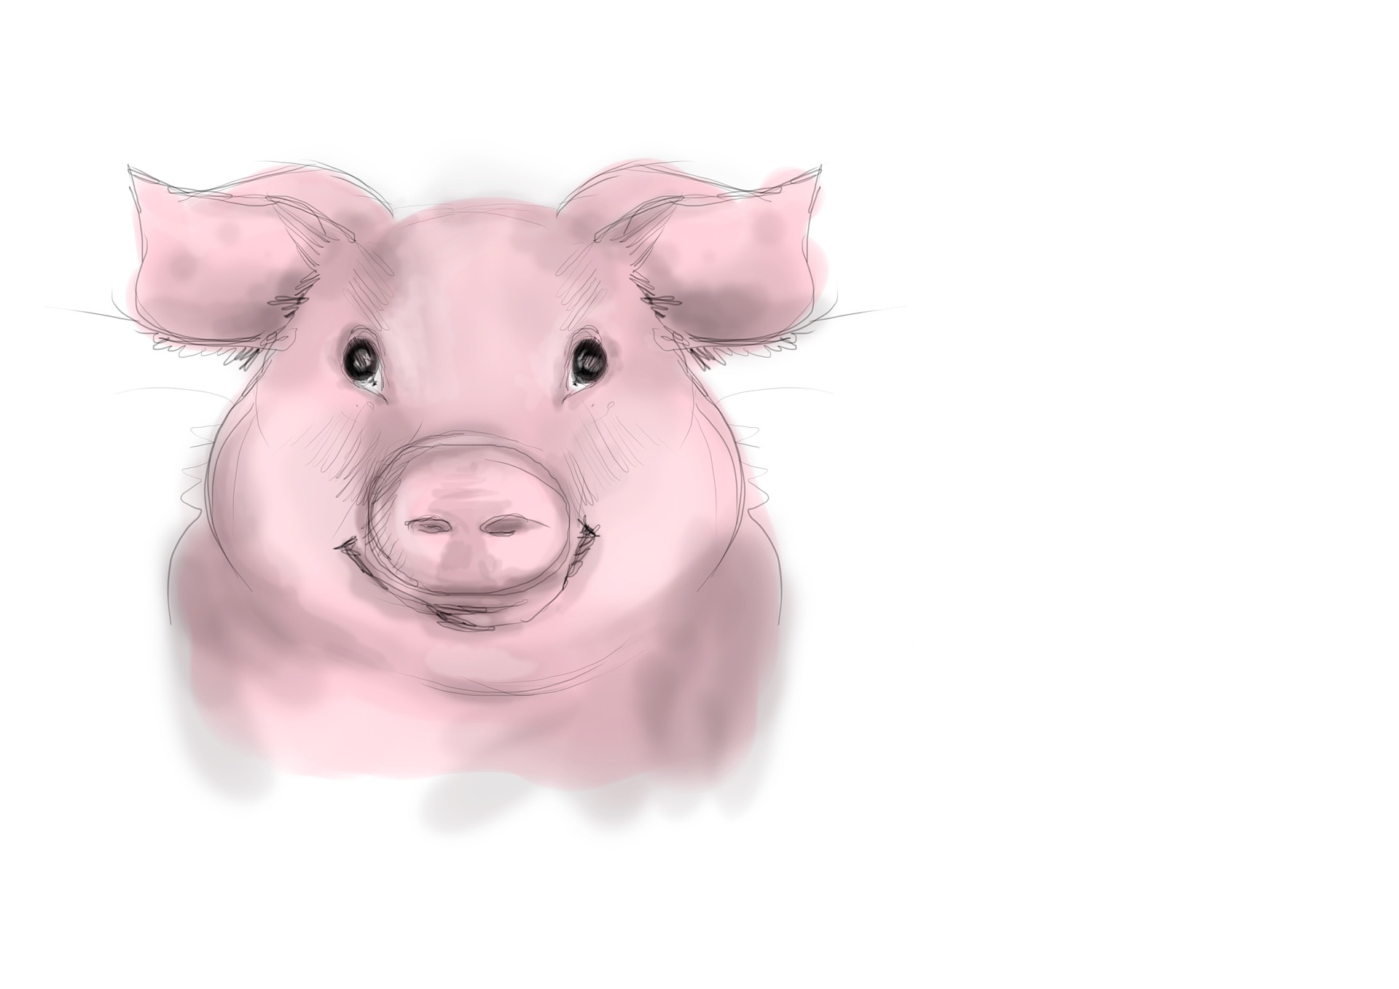
Getting Help
You can search for help using help.search(‘ ’)
If you know the function or command name, then you can get help by typing help(functionname).
Google search or stack overflow
Rstudio community

Slide 11
Workspace (working directory)
getwd() # shows your workspace during r session
setwd("C:/YOUR DIRECTORY”)
# sets your workspace during r session
Separate working directory for different projects.

Slide 12

Arithmetic Operators
Operator | Description
+ | Adds values on either side of the operator.
- | Subtracts.
* | Multiplies
/ | Divides
^ or ** | Performs exponential (power) calculation on operators
Logical Operators
Operator | Description
< | Less than
<= | Less than or equal to
> | Greater than
>= | Greater than or equal to
!x | Not x
x|y | x Or y
x & y | x AND y
isTRUE(x) | Test if x is TRUE

Slide 13
Assignment Operators
Operator | Description
x <- value | Stores value in an object
x <<- value
value -> x
value ->> x
X= value

Slide 14
Making comments
# here is my comment.
Commenting within your code is important as it helps you and others retrace your steps!

Slide 16
Creating data
Basics syntax
x <- c(1,3,2,5)
x # prints the object
y = c(1,4,3)
v <- TRUE
print(class(v))

Slide 17
Basic types of classes
R has 5 basic classes (atomic)
logical (TRUE, FALSE)
integer (2L, as.integer(3))
numeric (real or decimal) (2, 2.1)
complex (1 + 0i, 1 + 4i)
character (e.g, "a", "swc")

Slide 18
Creating data
Whats in your object?
x <- c(1,3,2,5)
x
> x
[1] 1 3 2 5
y = c(1,4,3)
> y
[1] 1 6 2

Slide 19
Creating data
Valid objects in R
total
Sum
.fine.with.dot
this_is_acceptable

Slide 20
Creating data
Invalid objects in R
tot@l
5um
_fine
TRUE

Slide 21
Charater vectors
x <- c("Hello", "world!")
x

Slide 22
Create random numbers
Number of values in object vector
RandomNumbers <- runif(100, 1, 100)
Between this range

Slide 24

Vectors/ Lists/ Data Frames
Basic types of data objects in R are:
Vector: x<-c(5,5,5,19,4,1,10,17)
n = c(2, 3, 5)
List: x = list(x, n, 3)
Data frame: df = data.frame(n, x)
mtcars mpg cyl disp hp drat wt ... Mazda RX4 21.0 6 160 110 3.90 2.62 ... Mazda RX4 Wag 21.0 6 160 110 3.90 2.88 ... Datsun 710 22.8 4 108 93 3.85 2.32 ...

Slide 25
Basic types of data objects in R are:
Vectors: basic data structure in R. It contains element of the same type. The data types can be logical, integer, double, character, complex or raw.
List: R objects which contain elements of different types like − numbers, strings, vectors and another list inside it.
Data frame: list of equal-length vectors. Each column contains values of one variable and each row contains one set of values. Most commonly used in data analysis.

Slide 26

Basic types of data objects in R
Matrix
A matrix is a collection of data elements arranged in a two-dimensional rectangular layout. The following is an example of a matrix with 2 rows and 3 columns.
x=matrix(data=c(1,2,3,4), nrow=2, ncol=2)
x
> x
[,1] [,2]
[1,] 1 3
[2,] 2 4
*Not covered in this course

Slide 27
Variables
Alphabetic character representing a number called the value or a series of values.
Using calculations with variables gives one greater ability to solve a range of problems in a single computation.
> mydata
a b
1 1 red
2 2 white
3 3 red
4 4 green

Slide 28
Variables
> mydata
a b
1 1 red
2 2 white
3 3 red
4 4 green
Single out variables
mydata$a
# or
mydata[[‘a']]
> mydata[['a']]
[1] 1 2 3 4

Slide 29
Create data- Vectors/ Lists
a <- c(1,2,3,4)
b <- c("red", "white", "red","green")
mydata <- data.frame(a,b)

Slide 30
Create data- data frame
a <- c(1,2,3,4)
b <- c("red", "white", "red","green")
mydata <- data.frame(a,b)
> mydata
a b
1 1 red
2 2 white
3 3 red
4 4 green

Slide 31
Create data- data frame
data <- read.table(header=TRUE, text='
YEAR DATA
2000 45
2001 55
2002 53
2003 54
2004 49
2005 55
2006 65
2007 54
2008 49
2009 53
2010 58
2011 55
2012 59
')
df<-c(1,2,3,4)
head(df)
typeof (df)

Slide 32
Rename or create variable names
names(mydata) <- c("x1","x2")

Slide 33
Checking data types
typeof(object) #check class type of the object
length(object) # number of elements or components
str(object) # structure of an object
class(object) # class or type of an object
names(object) # names

Slide 34
missing values
Variables of each data type (numeric, character, logical) can also take the value NA: not available.
- NA is not the same as 0
- NA is not the same as FALSE
> NA==1
[1] NA
> 1+NA
[1] NA
> max(c(NA, 4, 7))
[1] NA
> max(c(NA, 4, 7), na.rm=T)
[1] 7

Slide 36
Packages and functions
R Package is a group of functions that have a common objective.
R Packages are add-ons that users write (developers).
Extends the capabilities of R.
They are available for free download from the CRAN site.
Some are on github and other sources.

Slide 37



Packages and functions
Functions
Package

Slide 38

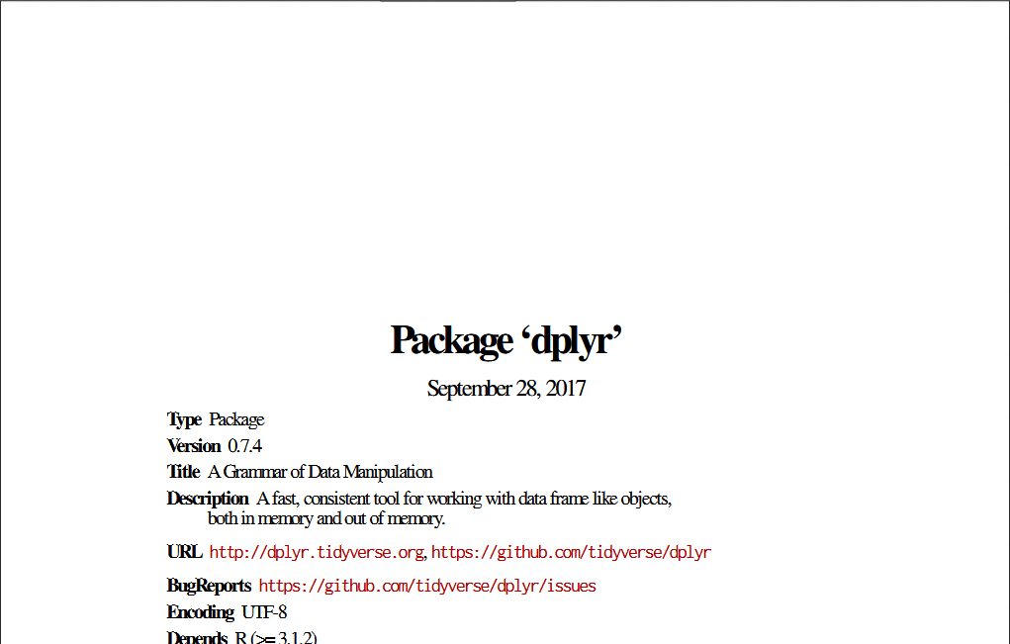
Packages documentation

Slide 39
Packages and functions
A function is a set of statements organized together to perform a specific task. R has a large number of in-built functions and the user can create their own functions.
Function Components
Function Name
Arguments
Function Body
Return Value
times <- function(x,y) {
x*y
}
times(2,4)
8

Slide 40
Packages and functions
install.packages("dplyr") library(dplyr)
install.packages(c("dplyr", "ggplot2"))
library(dplyr)
library(ggplot2)

Slide 41
File types
Formats of data tables:
Text file- .txt -Extension
CSV- .csv -Extension
Excel- .xls or .xlsx -Extension
Popular format for transferring data from one application to another.

Slide 42
File types
Formats of data tables:
Text file: a file that contains text and no special formatting.

Slide 43
File types
Formats of data tables:
CSV: comma-separated values, used to store tabular data, such as a spreadsheet or database.

Slide 44
File types
Formats of data tables:
Excel: file created with an electronic spreadsheet program used to store data

Slide 45
Importing and exporting data
There are many ways to get data into R and out of R.
x = read.delim(“filename.txt”)
also: read.table, read.csv
write.table(x, file=“x.txt”, sep=“\t”)

Slide 46
Loading data
setwd("F://directory")
df<-read.table("iris_data.txt",sep = ",")
df<-read.table("iris_data.txt",sep = "," ,col.names=c("VAR1", "VAR2", "VAR3", "VAR4","VAR5"))
df
Using text file

Slide 47
Loading data
Using CSV
df<-read.csv(file= "C:\\DIRECTORY\\PRAC_DATA.csv")
df
read.table("C:\\DIRECTORY\\PRAC_DATA.csv", header=TRUE, sep=",")

Slide 48
Loading data
Using Excel
library(readxl)
df<- read_excel("PRAC_DATA.xls", sheet = "Sheet1")

Slide 50
Exporting data
Using CSV
tdata <- c(76,95,77,78,99)
write.csv(tdata, file = "E:/DIRECTORY/data.csv")

Slide 51
Exporting data
Using Excel
library(writexl)
write_xlsx(df,"C:\\DIRECTORY\\file name.xlsx")

Slide 52
Exporting data
Text
# Loading mtcars data
data("mtcars")
# Writing mtcars data
write.table(mtcars, file = "mtcars.txt", sep = "\t",
row.names = TRUE, col.names = NA)

Slide 53
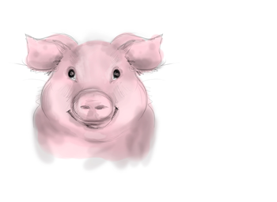
Storing data (the better way)
R objects can be stored into a file with the commands
“saveRDS” and “readRDS”.
saveRDS(x, file=“data.RDS”)
readRDS(“data.RDS”)

Slide 54
?

Slide 55



